Slide 1
IoT BASED HOME AUTOMATION

Slide 2

GOVERNMENT POLYTECHNIC NAGPUR
(An Autonomous Institute of Government of Maharashtra)
Presentation On
IoT BASED HOME AUTOMATION
Sr. No. | Enrollment No. | Name Of The Student
1. | 1904038 | GANESH MOROLIYA
2. | 1904042 | YUGAL NASARE
3. | 1904044 | CHIRAG PABARI
4. | 1904058 | PAWAN SORTE
5. | 1904053 | APSANA SHEIKH
Guided By : Prof. Sachine Kale
DEPARTMENT OF
ELECTRONICS AND TELECOMMUNICATION ENGINEERING
Academic Session 2020-2021

Slide 3
CONTENTS
Objective
Introduction
Literature survey
Hardware Used
Hardware Description
Software Used
Construction
Block Diagram
Circuit Diagram
Advantages
Disadvantages
Conclusion
References

Slide 4
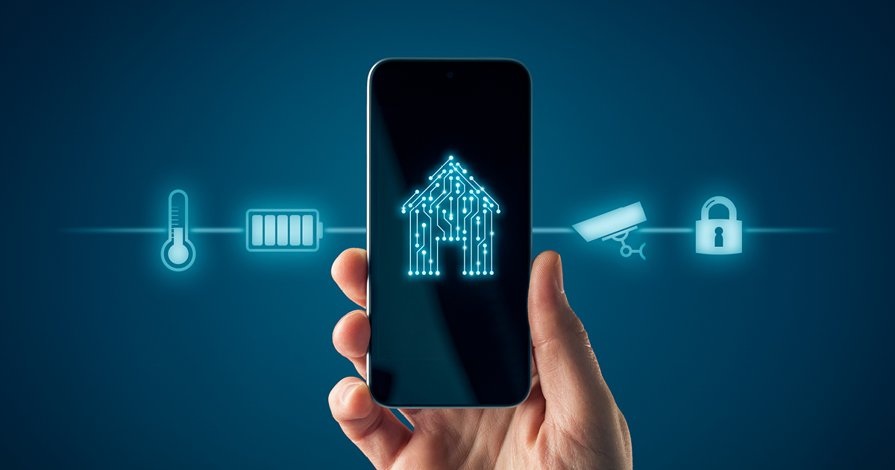
OBJECTIVE
In the modern world or time the technology is improving day by day.
In this time the people want to do work with less efforts and gain more profit.
So, this can be achieve with the help of Home Automation Invention with it is the best and cheapest way.
Security help, people that will enable them to control home appliances and alert them in critical situations.

Slide 5
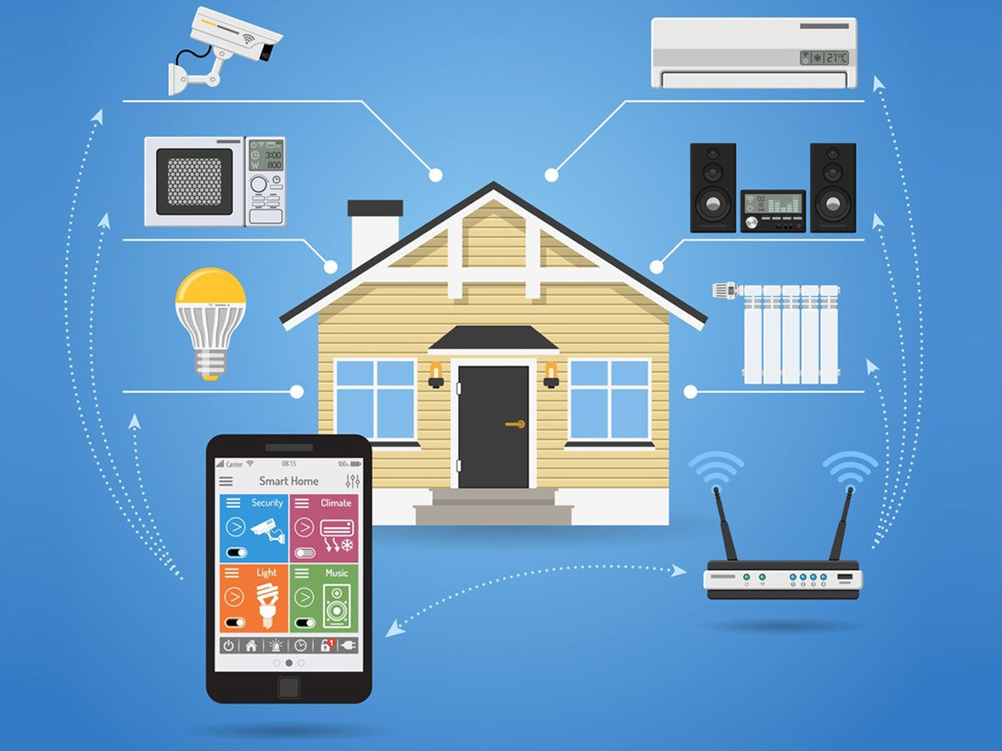
INTRODUCTION
Home automation refers to the automatic and electronic control of household features and appliances.
With smart home devices, you can remotely monitor your home appliances and ensure that all devices are safely switched off.
With the help of this project we can control the appliances connected with our home and other commercial area through our smartphone

Slide 6
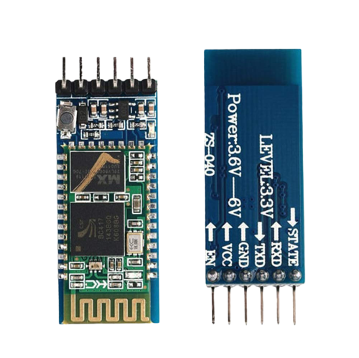
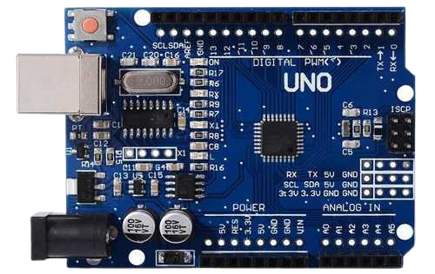
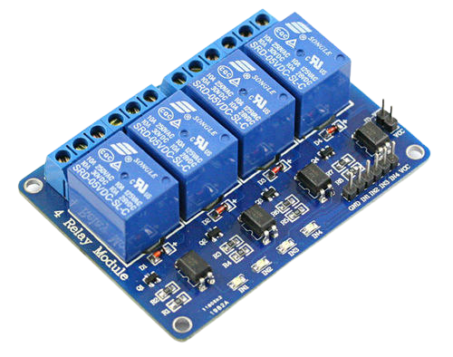
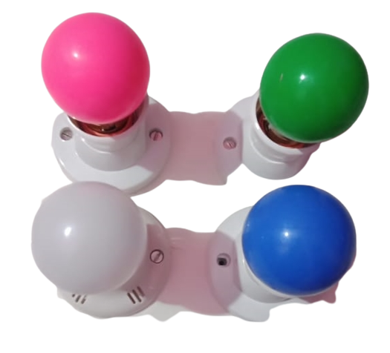
HARDWARE USED
Bluetooth
Module
HC05
Arduino
UNO
Relay
Module
4 channel
Blubs Holder

Slide 7
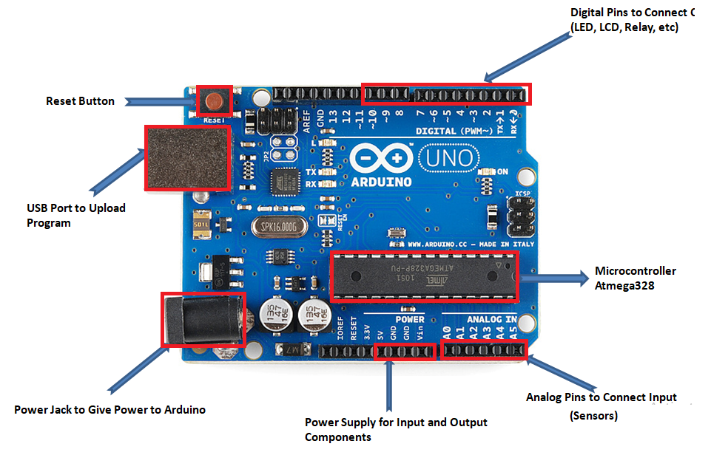
HARDWARE DESCRIPTION
ARDUINO UNO
Arduino UNO is a low-cost, flexible, and easy-to-use programmable open-source microcontroller board that can be integrated into a variety of electronic projects.
And it is open-source microcontroller board based on the Microchip ATmega328P.
Output Voltage: 5V
Input voltage: 5 To 12v

Slide 8
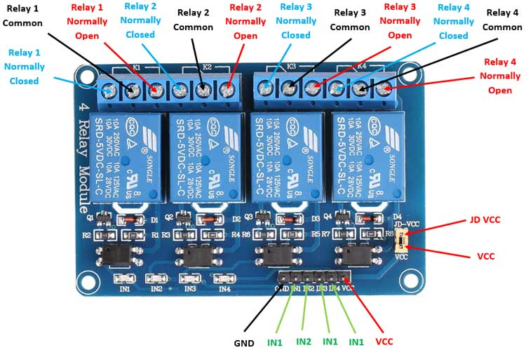
HARDWARE DESCRIPTION
RELAY MODULE
1. The relay module is an electrically operated
switch that can be turned on or off deciding
to let current flow through or not.
2. Operating voltage : 3.3 ~ 5V
3. Switching voltage : 240V/10A
4. Operating Temp. : -40 ~ 85ºc

Slide 9
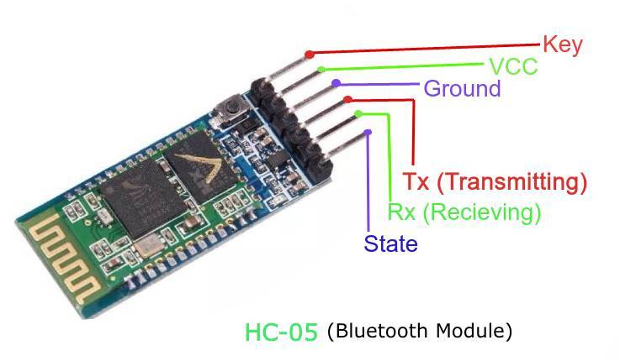
HARDWARE DESCRIPTION
BLUETOOTH MODULE
1. HC-05 is a Bluetooth module which is
designed for wireless communication.
2. This Bluetooth Module is used designed
for transparent wireless serial
3. Operating voltage : 4V to 5V

Slide 10
HARDWARE DESCRIPTION
BULBS HOLDER
In this load diagram of home automation we are using 230 v AC power supply and relay module is used to control the load.
There are four relay are used and each of relay is controlling the one load. And controlling four lights.

Slide 11

SOFTWARE USED
Arduino Bluetooth Control App
Control home electrical system using smart phone with android application and Bluetooth Control Device.
Bluetooth Control Device outputs to directly drive to the loads and operate it’s bulbs, Television, Fans etc.

Slide 12
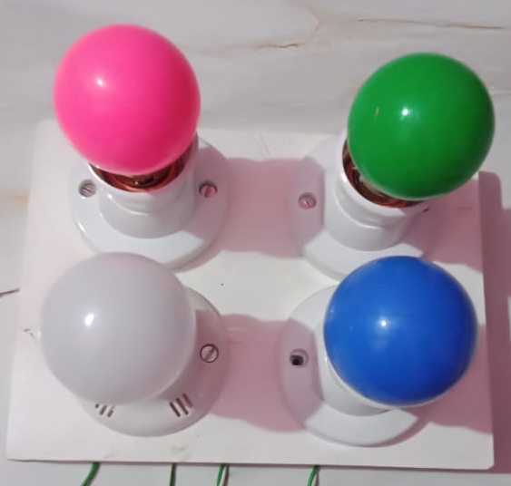
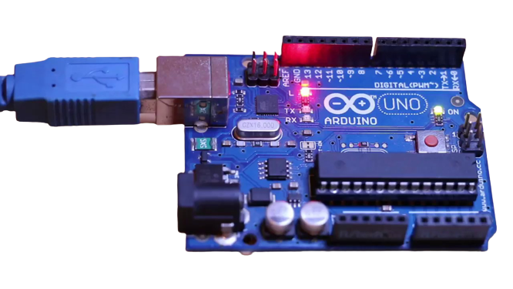
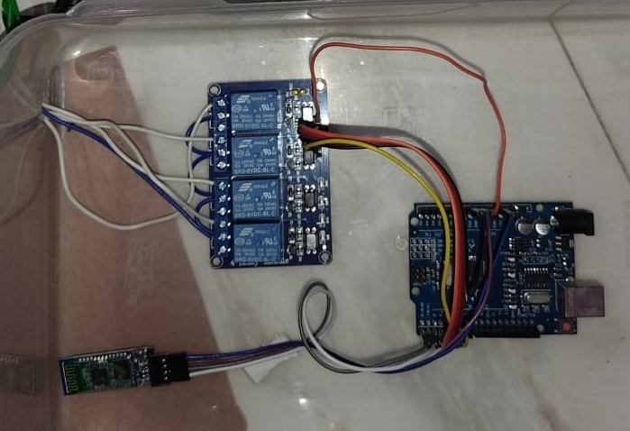

CONSTRUCTION

Slide 13
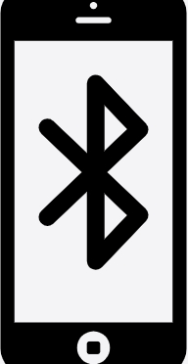
BLOCK DIAGRAM
ARDUINO UNO R3
BLUETOOTH MODULE(HC-05)
LOAD 1
12V RELAY MODULE
LOAD 2
LOAD 3
LOAD 4

Slide 14
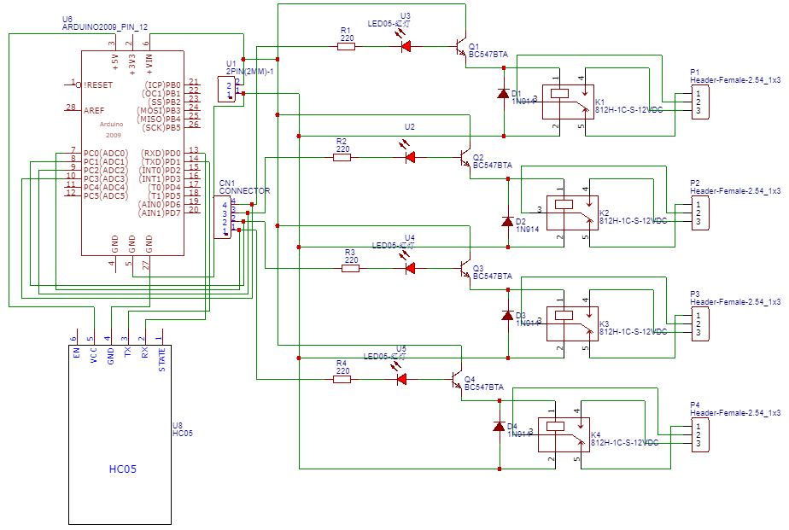
CIRCUIT DIAGRAM

Slide 15

ADVANTAGES
1. A single android smartphone can control multiple devices.
2. Maximizing home security.
3. Home automation using Bluetooth can be very useful for
Handicapped people.
4. There is no need for extra training of that person who is
using it.
5. Any android phone can be used, no internet required once the
app is downloaded.

Slide 16
DISADVANTAGES
1. Bluetooth is used in this home automation system, which have a range of 10 to 20 meters so the control cannot be achieved from outside this range.
2. Application is disconnected after disconnect of the Bluetooth.
3. When the new users want to connect, first download application software and then configuration must be done.
4. High power consumption because of Bluetooth connectivity.

Slide 17
CONCLUSION
1. Thus our objective to develop IoT based Home Automation system is fulfilled and our project is working efficiently.
2. It can also be developed with the help of GSM module it has one drawback multiple users share the same bandwidth and it may cause interference.
3. But such drawbacks can be overcame by IoT and giving better results.
4. As it is era of Automation, we can use this concept in various fields including agriculture etc to reduce our efforts.

Slide 18
REFERENCE
https://youtu.be/YyLu8aPNjWE
https://robu.in/product/5v-4-channel-relay-module/?gclid=Cj0KCQjwpv2TBhDoARIsALBnVnkODIzzFh8_TtRTiSFrleMA4xoY-WvK1zcYOsVuq5pl77On-H3FeToaApr8EALw_wcB
https://www.theengineeringprojects.com/2018/10/introduction-to-arduino-ide.html
https://youtu.be/TZnrHkjlgLk

Slide 19
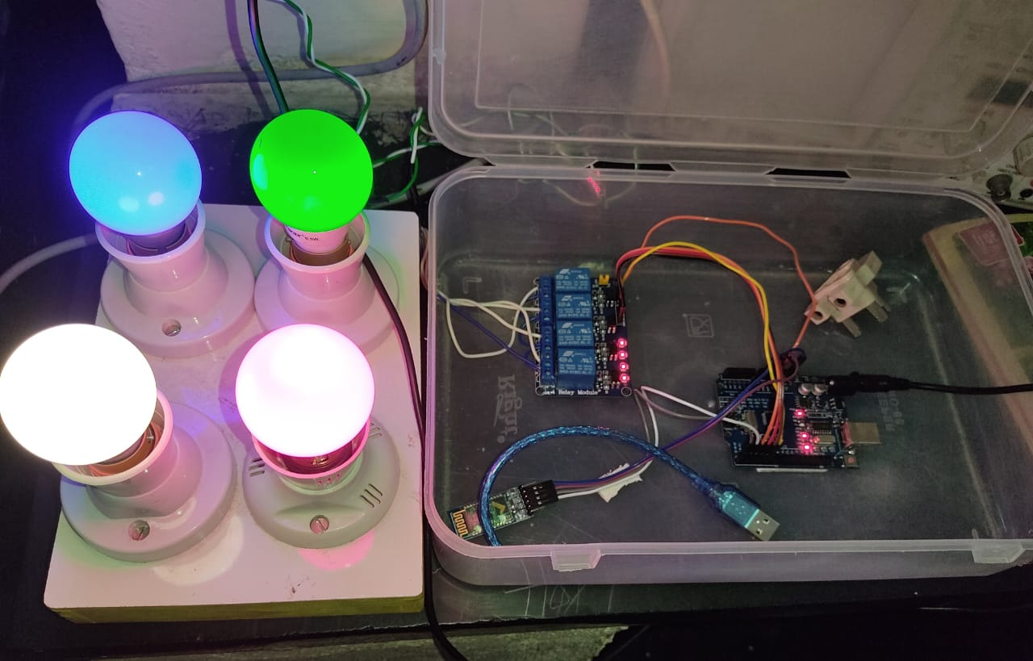
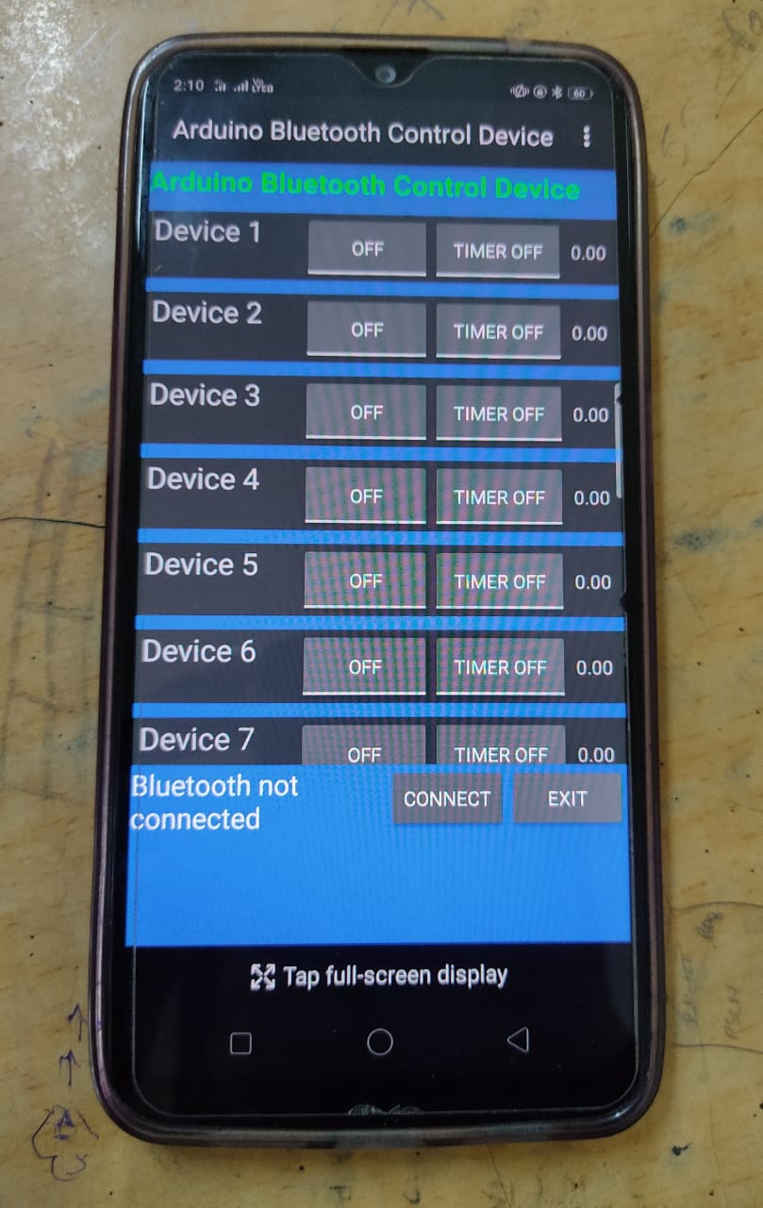
PROJECT FINAL VIEW

Slide 20

THANK YOU

